Slide 1

Deloitte Pre Hire Training 2017
FOUNDATION TRAINING
Spring Core

Slide 2
Core Spring
Spring with Hibernate

Slide 3
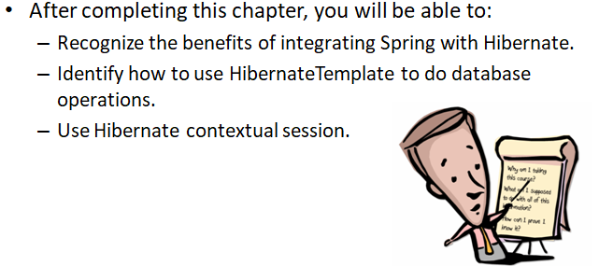
Objectives

Slide 4
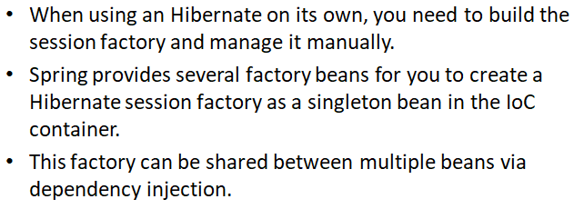
Why Spring

Slide 5
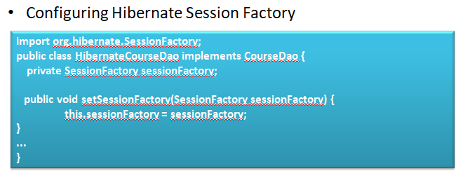
Configuring Hibernate Session Factory

Slide 6
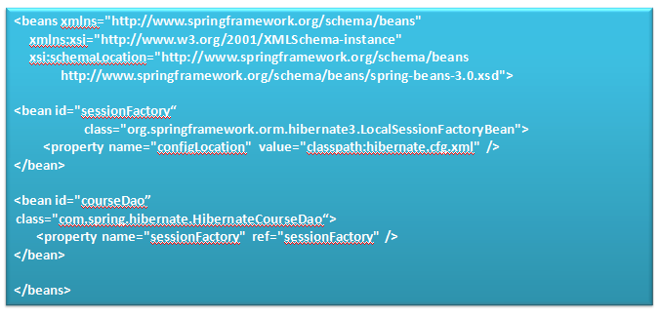
Configuring Hibernate Session Factory

Slide 7
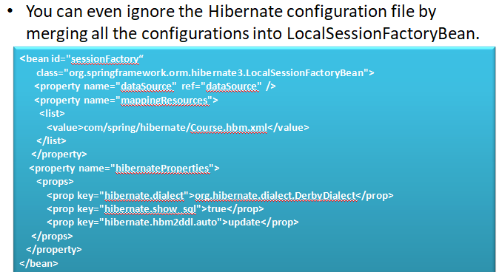
Configuring Hibernate Session Factory

Slide 8
Demo
On how to configure Hibernate SessionFactory

Slide 9
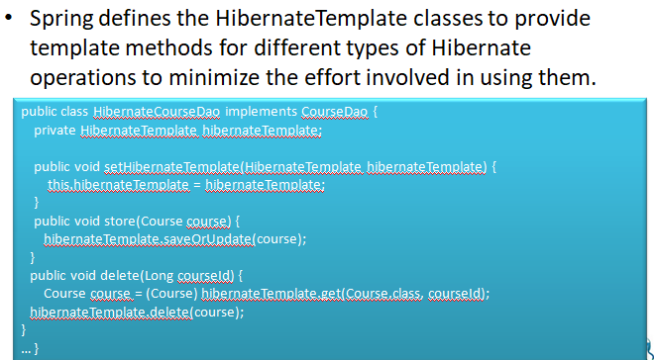
Hibernate Template

Slide 10
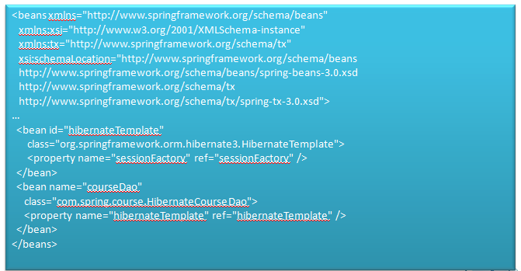
Hibernate Template

Slide 11
Demo
Write a simple code to explain Hibernate Template

Slide 12
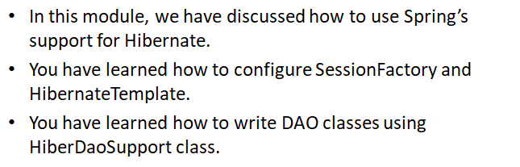

Summary

